Slide 1
Subreddit Classification

Slide 2
General Workflow
Import libraries
Scrape Data
Clean/ Pre-process data
EDA
Modelling

Slide 3
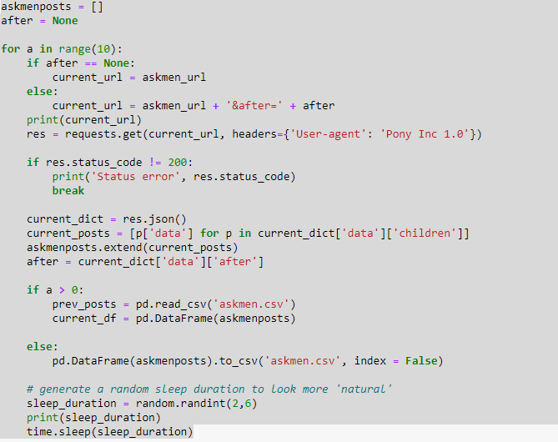
Scraping the data
In order to get the data to be used. I had to scrape the data from Reddit’s api.
As there was a limit of 1000 posts, up to 2000 posts could be collected in total
The code provided will request from reddit api until the specified number of loops were reached

Slide 4
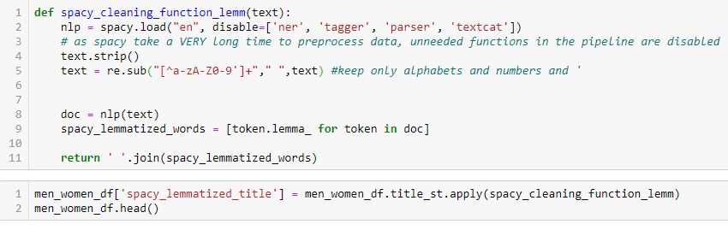
Data cleaning
After putting all the necessary data into a dataframe, the raw text needed to be cleaned as it was full of unusable characters (punctuations, emojis, pictures, etc.)
In addition to cleaning the text, it also need to be lemmatized to the root form so that the words could be properly analyzed. (eg. Helping to help, arrived to arrive, etc.)

Slide 5
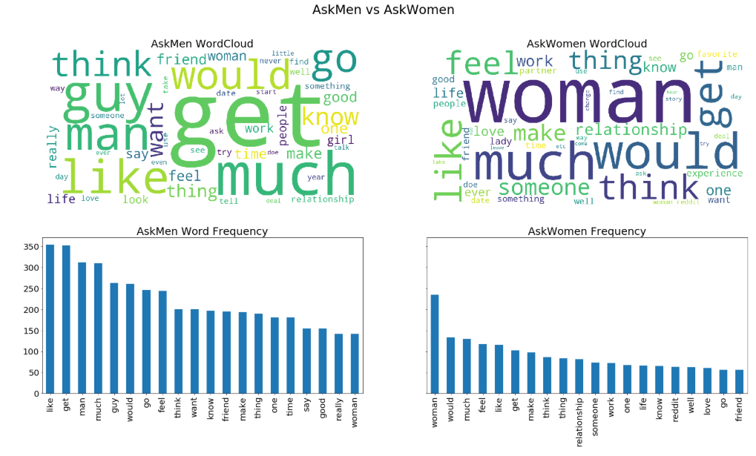
Most frequent words for subreddits

Slide 6
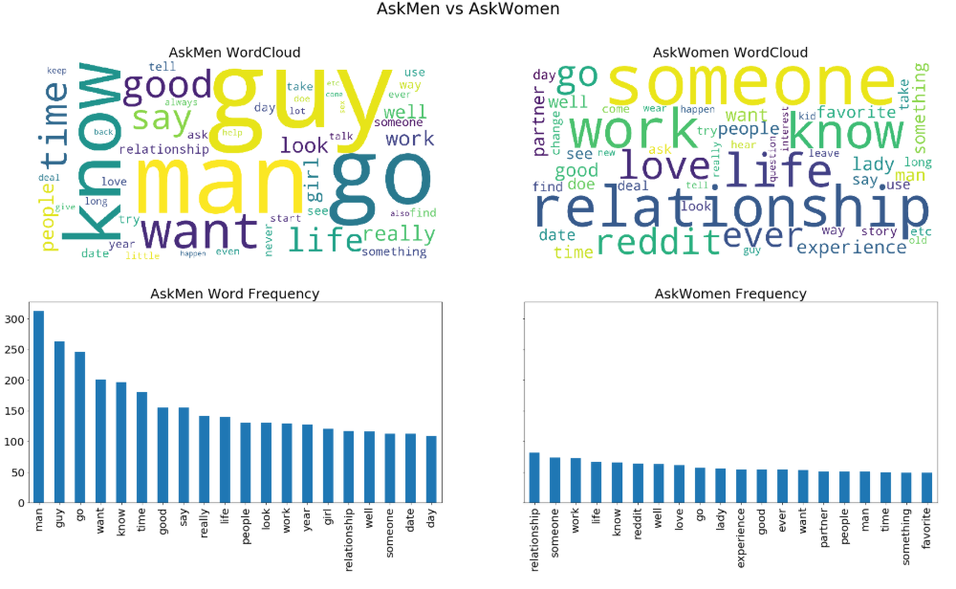
Most frequent words for subreddits after removing common words

Slide 7
Wordcloud for subreddits
There were a few words that the subreddits had in common.
Men generally had more counts of theses words.
Women had more unique words as their top few words

Slide 8
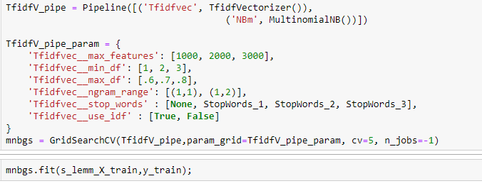
Modelling
For each model, different parameters were run through the grid search into order to find the best parameters.

Slide 9
Model assessment
Models are assessed based on:
  accuracy (overall ability to correctly classify subreddits
  Recall (ability to correctly classify Askmen)
  Specificity (ability to correctly classify AskWomen)

Slide 10
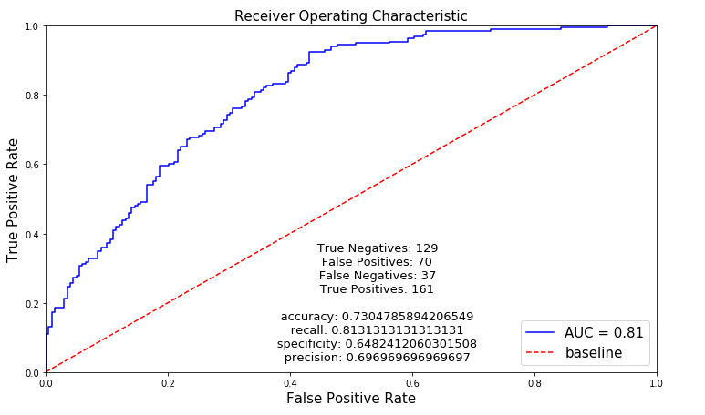
Model assessment - Naïve Bayes

Slide 11
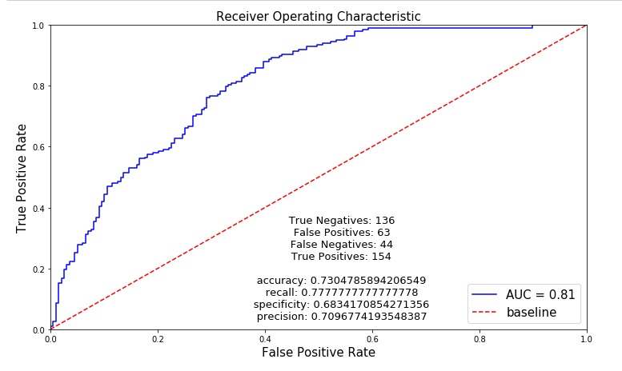
Model assessment – Log Regression

Slide 12
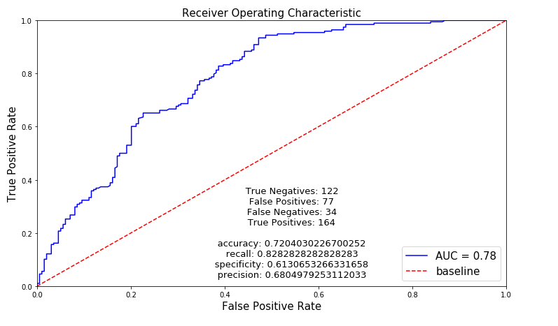
Model assessment – Random Forest

Slide 13
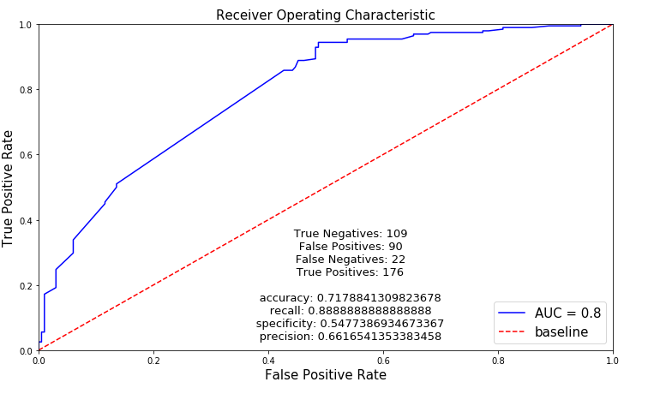
Model assessment – AdaBoost

Slide 14
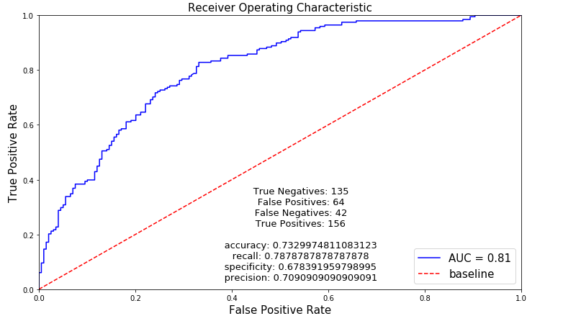
Model assessment – Support Vector Machine

Slide 15
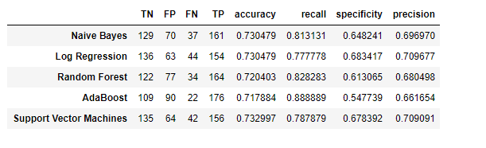
Comparson of models
A quick comparison of the models show that although the accuracy is roughly the same, Recall and specificity are quite different for each model.
This demonstrates that each models has its own strengths and weaknesses

Slide 16
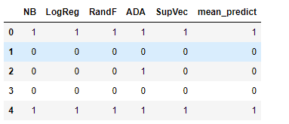
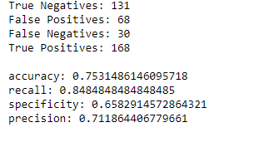
Ensemble model
An aggregate score was calculated based on the 5 models
This new aggregated prediction was the most accurate model.

Slide 17
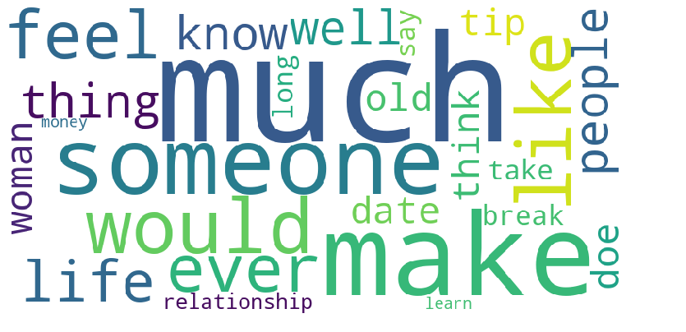
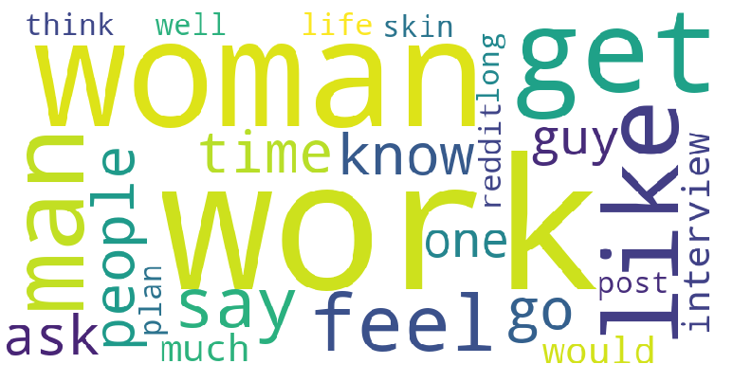
Most common words in misclassified subreddits
Askmen
Misclassified subreddits tend to contain words that are common in other subreddits.
Might be a weakness in the bag of words approach
AskWomen

Slide 18
Conclusion
The models produced above are some what able to differentiate between r/askmen and
Models are generally able to correctly classify AskWomen posts better than AskMen
Perhaps in the future a learning method that captures context would be a more accurate way to classify posts.

